Slide 1




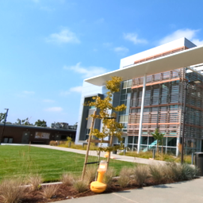
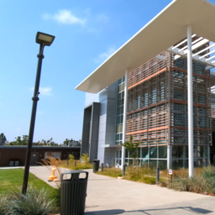
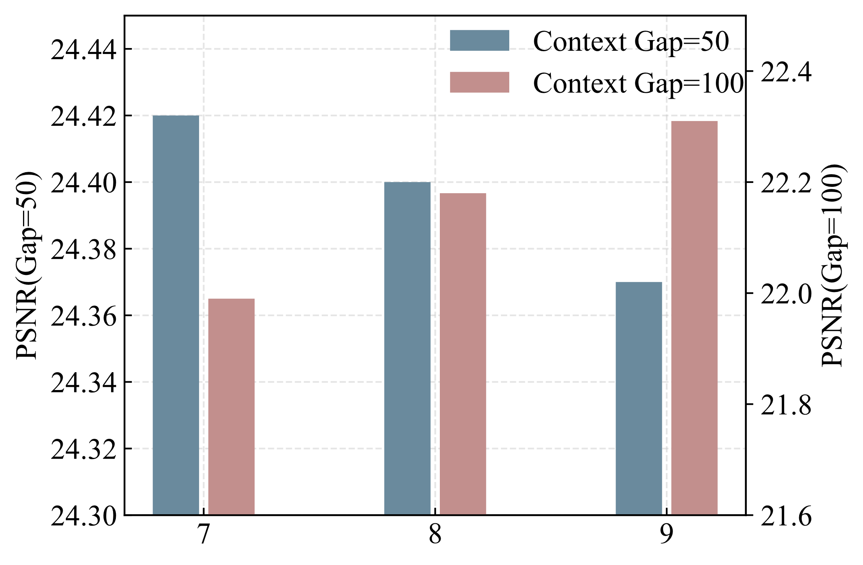
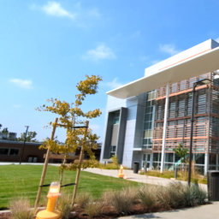
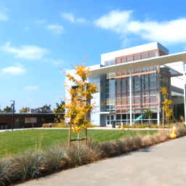
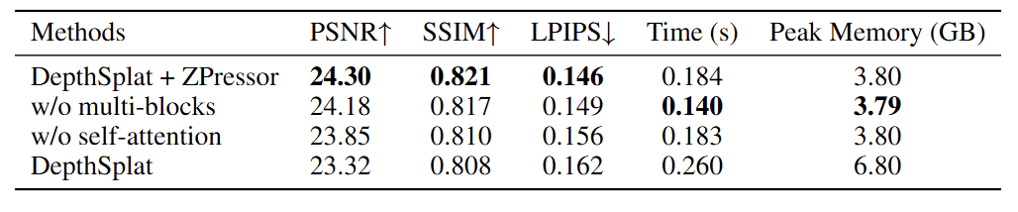
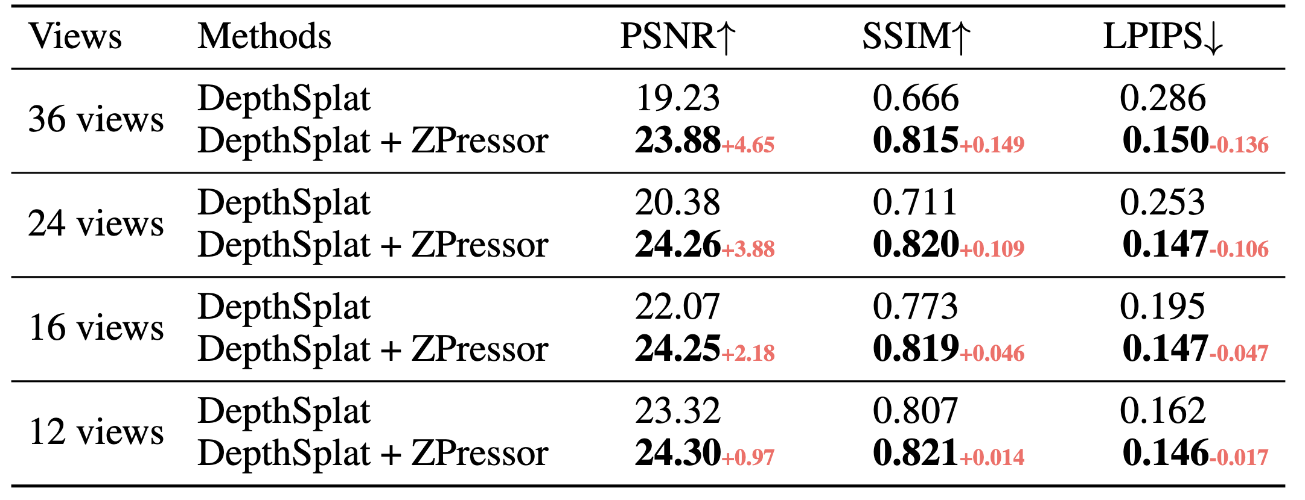
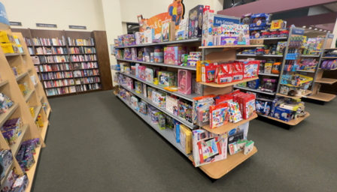
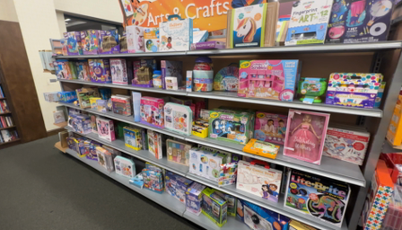
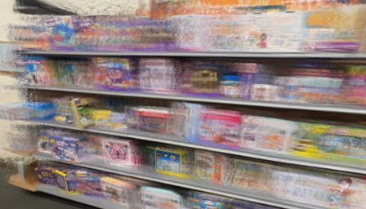
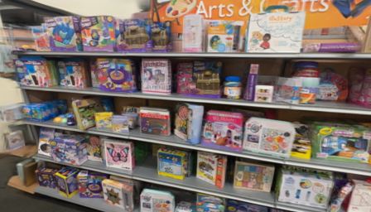
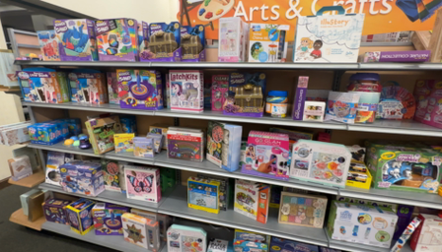
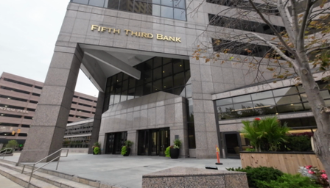
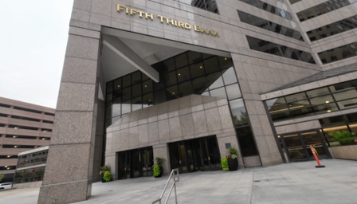
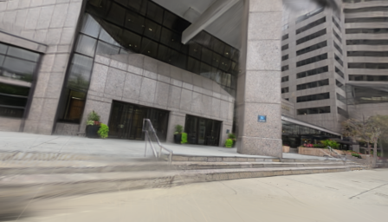
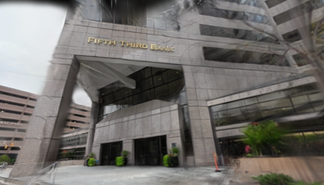
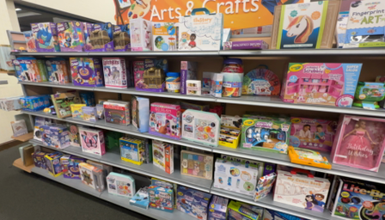
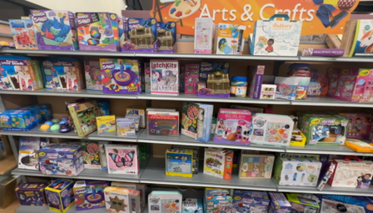
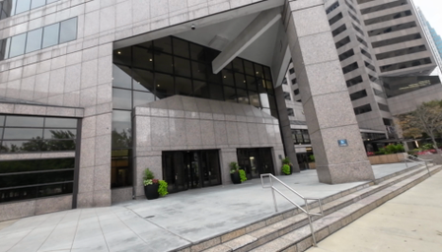
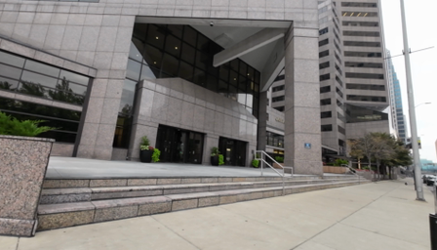
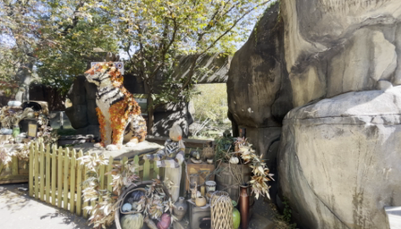
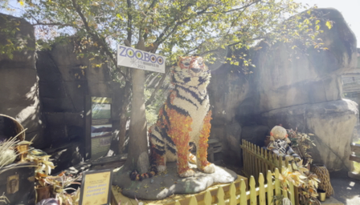
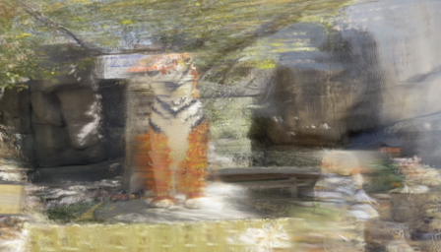
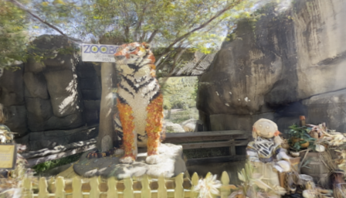
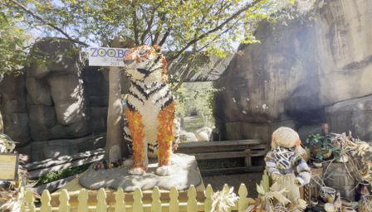
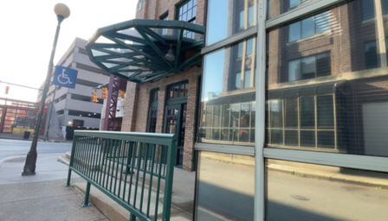
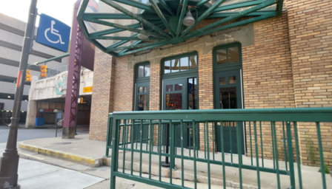
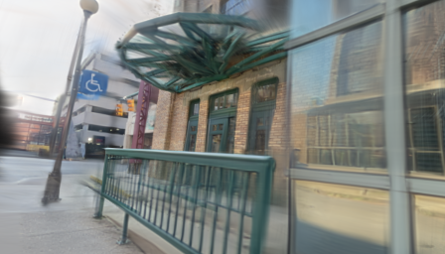
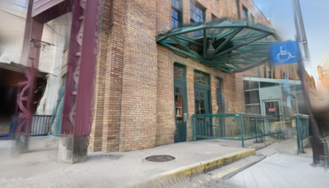
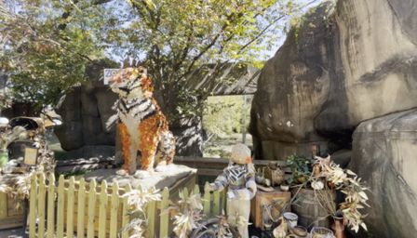
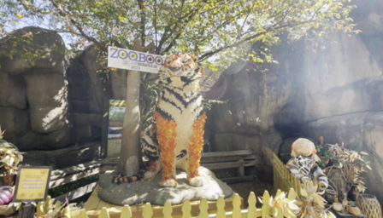
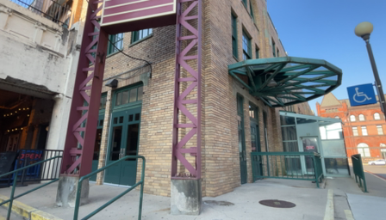
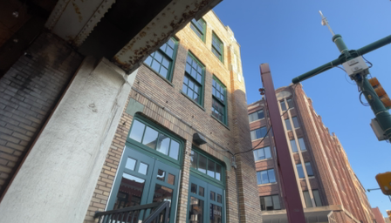
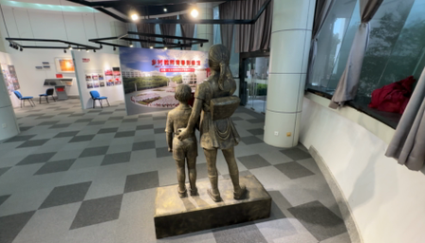
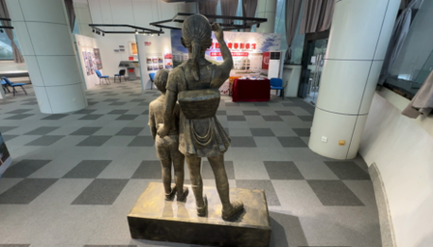
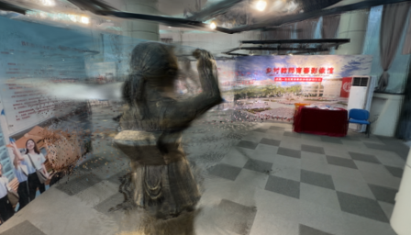
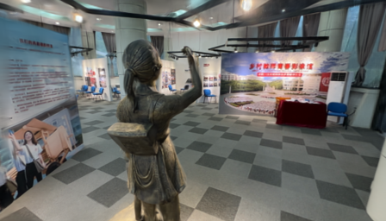
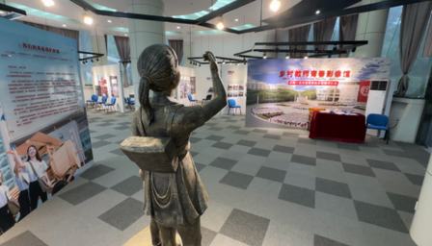
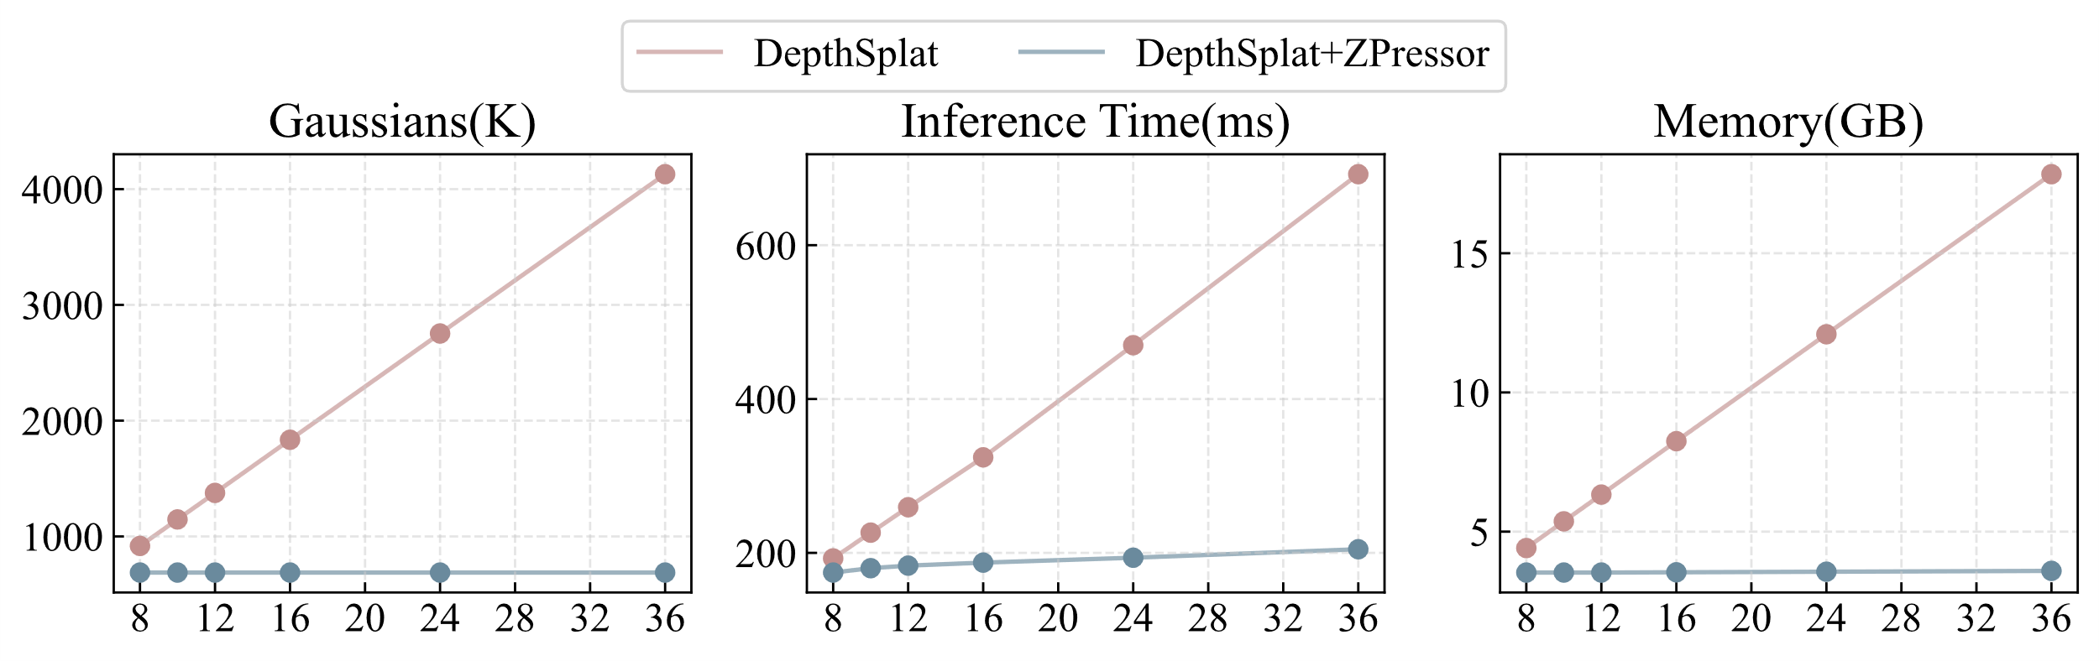
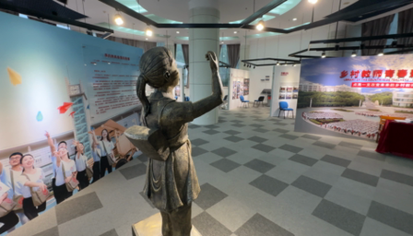
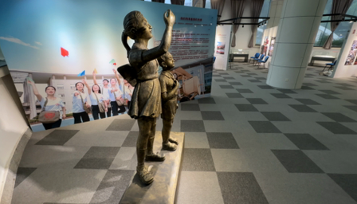





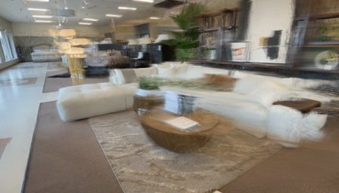





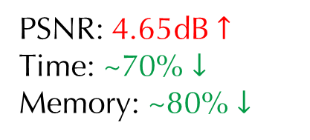

ZPressor: Bottleneck-Aware Compression for
Scalable Feed-Forward 3DGS
Weijie Wang, Donny Y. Chen, Zeyu Zhang, Duochao Shi, Akide Liu, Bohan Zhuang
MOTIVATION
APPROACH
ABLATION STUDY
Feed-Forward 3DGS
Feature Extractor
ZPressor
Gaussian Predictor
Analysis of bottleneck:
Different levels of complexity benefit from different bottlenecks
Images
Efficient Extraction
Images
Images
Images
Images
Images
Images
High Memory and latency
Target
Bottleneck-aware compress
Images
Images
PSNR: 4.65dB $↑$
Time: ~70% $↓$
Memory: ~80% $↓$
Images
Low compute source, high performance
Target
Feed-Forward 3DGS + ZPressor
Input Feature $Χ$
Step 1: Select anchor views.
Step 2: Assign other views to the corresponding group.
Step 3: Merge support views features into anchor views
Output Feature $Ζ$
Why existing models fail to scale?
Fundamentally constrained by the limited capacity of their models.
TL;DR: ZPressor is a lightweight architecture-agnostic module that enables efficient compression of multi-view inputs for scalable feed-forward 3DGS.
Effective compression preserves essential scene information.
EXPERIMENTAL ANALYSIS
COMPARISONS
LIMITATIONS
HIGHER EFFICIENCY
Inputs (~500 views)
DepthSplat + ZPressor
Still challenging under ultra-dense view settings.
Linear no more: constant memory, constant time.
Inputs
DepthSplat
ZPressor
Ground Truth
X
WeChat
Github

